Slide 1
Peer to Peer Networking
Acknowledgements: Slides modified from
Sukumar Ghosh, U at IOWA
Mark Jelasity, Tutorial at SASO’07
Keith Ross, Tutorial at INFOCOM
Notes:
Bittorrent slides; and skype slides; bitcoin slides
Paper to read; slides on skype; named data networking; bitcoin;

Slide 2
P2P- How Did it Start?
A killer application: Napster
  Free music over the Internet
Key idea: share the computing power, storage and bandwidth of individual users, rather than relying on a relatively small number of servers
Internet
Notes:
A peer-to-peer (or P2P) computer network is a network that relies on the computing power and bandwidth of the participants in the network rather than concentrating it in a relatively low number of servers.

Slide 3
Characteristics
No always on server
End systems communicate directly
Peers are intermittently connected and change IP addresses
Example
  BitTorrent
  Skype

Slide 4
Model
Each user stores a subset of files
Each user has access (can download) files from all users in the system

Slide 5
Main Challenge
Find where a particular file is stored
  Content based vs URL based
  Note: problem similar to finding a particular page in web caching
E
F
D
E?
C
A
B
Notes:
Content based versus URL

Slide 6
Other Challenges
Scale: up to hundred of thousands or millions of machines
Dynamicity: machines can come and go any time

Slide 7
Napster: Example
m5
m6
E
F
D
E?
E
m1 A
m2 B
m3 C
m4 D
m5 E
m6 F
m4
E?
m5
C
A
B
m3
m1
m2

Slide 8
Napster
Assume a centralized index system that maps files (songs) to machines that are alive
How to find a file (song)
  Query the index system → return a machine that stores the required file
    Ideally this is the closest/least-loaded machine
  ftp the file
Advantages:
  Simplicity, easy to implement sophisticated search engines on top of the index system
Disadvantages:
  Robustness, scalability (?)

Slide 9
Gnutella: Example
Assume:
  A overlay network or a virtual network is formed among participants of Gnutella
  m1’s neighbors are m2 and m3; m3’s neighbors are m4 and m5;…
m5
m6
E
F
D
E
E?
E?
m4
E?
E?
C
A
B
m3
m1
m2
Notes:
join
Overlay network

Slide 10
Gnutella
Distributed file location
Idea: nodes form a overlay network; send the request to multiple neighboring nodes
How to find a file:
  Send request to all neighbors
  Neighbors recursively send the request to their neighbors
  Eventually a machine that has the file receives the request, and it sends back the answer
Advantages:
  Totally decentralized, highly robust
Disadvantages:
  Not scalable: the entire network can be swamped with request
    to alleviate this problem, each request has a TTL, or use limited scope flooding
  Does not always guarantee that a file is found, even if the file is in the network
Notes:
Overlap network
Limited scope flooding

Slide 11

















Pure P2P Architecture
No always-on server
Arbitrary end systems directly communicate
Peers are intermittently connected and change IP addresses
Examples:
  file distribution (BitTorrent)
  Streaming (KanKan)
  VoIP (Skype)

Slide 12
P2P Systems
Use the vast resources of machines at the edge of the Internet to build a network that allows resource sharing without any central authority.
More than a system for sharing pirated music/movies

Slide 13
Characteristics of P2P Systems
Exploit edge resources.
  Storage, content, CPU, Human presence.
Significant autonomy from any centralized authority.
  Each node can act as a Client as well as a Server.
Resources at edge have intermittent connectivity, constantly being added & removed.
  Infrastructure is untrusted and the components are unreliable.

Slide 14
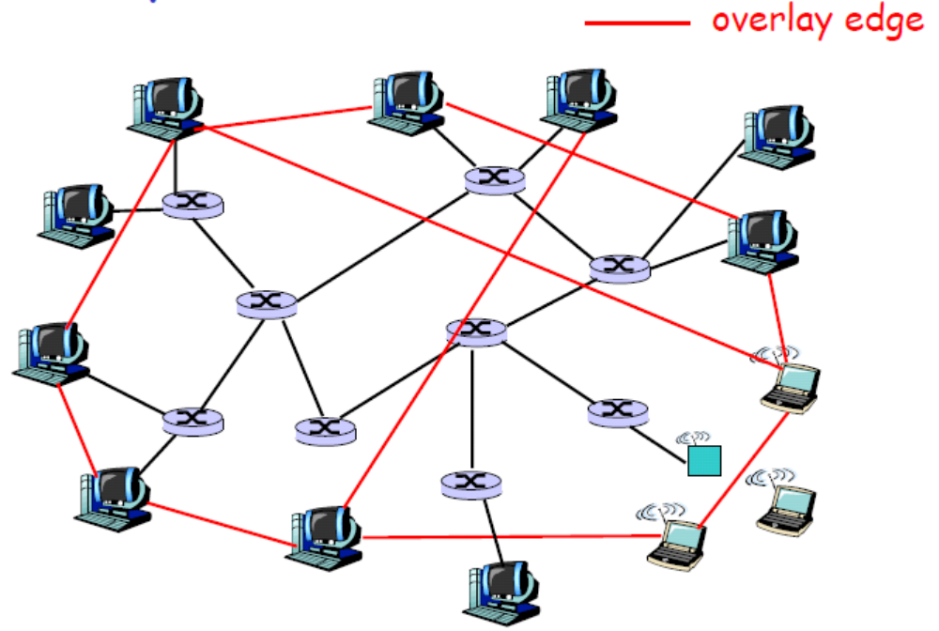
Overlay Network
A P2P network is an overlay network. Each link between peers consists of one or more IP links.

Slide 15
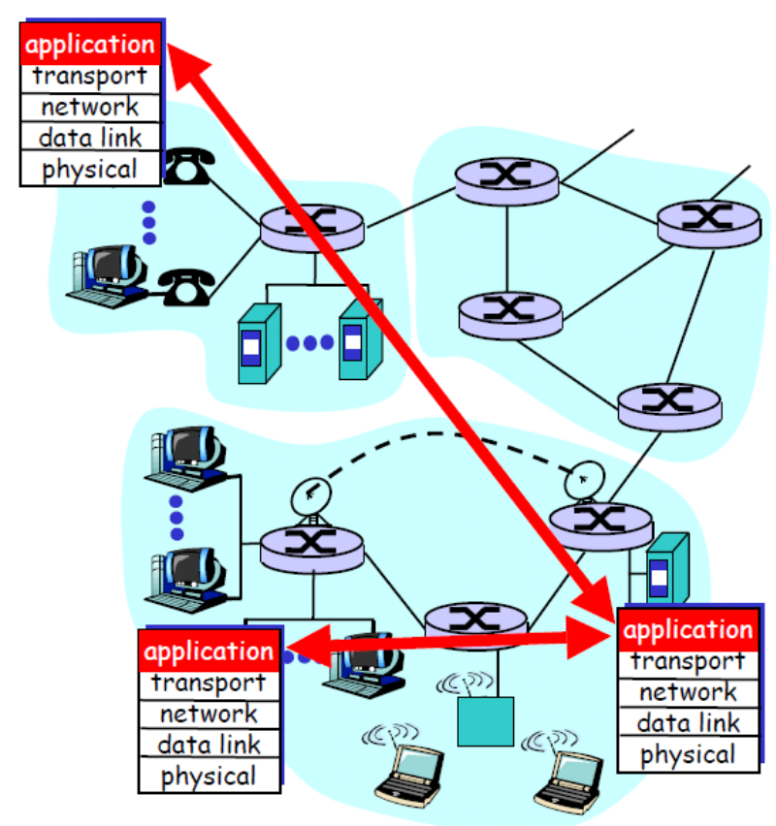
Overlays : All in the application layer
Tremendous design flexibility
  Topology, maintenance
  Message types
  Protocol
  Messaging over TCP or UDP
Underlying physical network is transparent to developer
  But some overlays exploit proximity

Slide 16
Overlay Graph
Virtual edge/link
  TCP connection
  or simply a pointer to an IP address
Overlay maintenance
  Periodically ping to make sure neighbor is still alive
  Or verify aliveness while messaging
  If neighbor goes down, may want to establish new edge
  New incoming node needs to bootstrap
  Could be a challenge under high rate of churn
    Churn: dynamic topology and intermittent access due to node arrival and failure

Slide 17
Overlay Graph
Unstructured overlays
  e.g., new node randomly chooses existing nodes as neighbors
Structured overlays
  e.g., edges arranged in restrictive structure

Slide 18
P2P Applications
P2P File Sharing
  Napster, Gnutella, Kazaa, eDonkey, BitTorrent
  Chord, CAN, Pastry/Tapestry, Kademlia
P2P Communications
  MSN, Skype, Social Networking Apps
P2P Distributed Computing
  Seti@home

Slide 19
P2P File Sharing
Alice runs P2P client application on her notebook computer Intermittently connects to Internet
Gets new IP address for each connection
Asks for “Hey Jude”
Alice chooses one of the peers, Bob.
Application displays other peers that have copy of Hey Jude.
File is copied from Bob’s PC to Alice’s notebook
While Alice downloads, other users upload from Alice.
P2P
P2P

Slide 20
P2P Communication
Instant Messaging
Skype is a VoIP P2P system
Alice runs IM client application on her notebook computer Intermittently connects to Internet
Gets new IP address for each connection
Register herself with “system”
Alice initiates direct TCP connection with Bob, then chats
Learns from “system” that Bob in her buddy list is active
P2P

Slide 21
P2P/Grid Distributed Processing
seti@home
  Search for ET intelligence
  Central site collects radio telescope data
  Data is divided into work chunks of 300 Kbytes
  User obtains client, which runs in background
  Peer sets up TCP connection to central computer, downloads chunk
  Peer does FFT on chunk, uploads results, gets new chunk
Not P2P communication, but exploit Peer computing power

Slide 22
Promising Properties of P2P
Massive scalability
Autonomy: non single point of failure
Resilience to Denial of Service
Load distribution
Resistance to censorship

Slide 23
Key Issues
Management
  How to maintain the P2P system under high rate of churn efficiently
  Application reliability is difficult to guarantee
Lookup
  How to find out the appropriate content/resource that a user wants
Throughput
  Content distribution/dissemination applications
  How to copy content fast, efficiently, reliably

Slide 24
Management Issue
A P2P network must be self-organizing.
  Join and leave operations must be self-managed.
  The infrastructure is untrusted and the components are unreliable.
  The number of faulty nodes grows linearly with system size.
  Tolerance to failures and churn
    Content replication, multiple paths
    Leverage knowledge of executing application
Load balancing
Dealing with freeriders
  Freerider: rational or selfish users who consume more than their fair share of a public resource, or shoulder less than a fair share of the costs of its production.

Slide 25
Lookup Issue
How do you locate data/files/objects in a large P2P system built around a dynamic set of nodes in a scalable manner without any centralized server or hierarchy?
Efficient routing even if the structure of the network is unpredictable.
  Unstructured P2P: Napster, Gnutella, Kazaa
  Structured P2P: Chord, CAN, Pastry/Tapestry, Kademlia

Slide 26
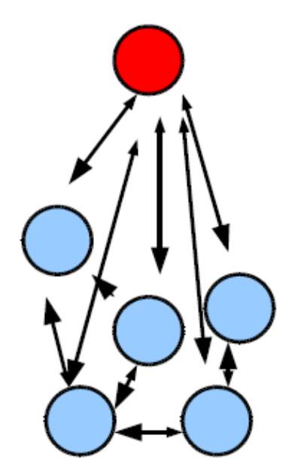
Napster
Centralized Lookup
  Centralized directory services
  Steps
    Connect to Napster server.
    Upload list of files to server.
    Give server keywords to search the full list with.
    Select “best” of correct answers. (ping)
  Performance Bottleneck
Lookup is centralized, but files are copied in P2P manner

Slide 27
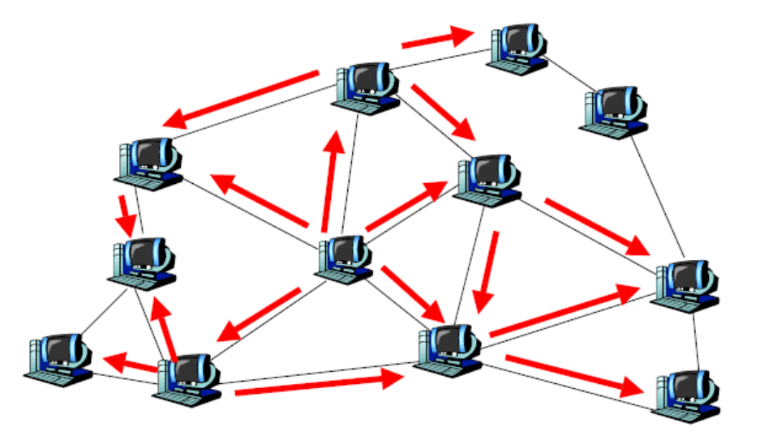
Gnutella
Fully decentralized lookup for files
  The main representative of “unstructured P2P”
  Flooding based lookup
  Obviously inefficient lookup in terms of scalability and bandwidth

Slide 28
Gnutella: Scenario
Step 0: Join the network
Step 1: Determining who is on the network
  "Ping" packet is used to announce your presence on the network.
  Other peers respond with a "Pong" packet.
  Also forwards your Ping to other connected peers
  A Pong packet also contains:
    an IP address
    port number
    amount of data that peer is sharing
    Pong packets come back via same route
Step 2: Searching
  Gnutella "Query" ask other peers (usually 7) if they have the file you desire
  A Query packet might ask, "Do you have any content that matches the string ‘Hey Jude"?
  Peers check to see if they have matches & respond (if they have any matches) & send packet to connected peers if not (usually 7)
  Continues for TTL (how many hops a packet can go before it dies, typically 10 )
Step 3: Downloading
  Peers respond with a “QueryHit” (contains contact info)
  File transfers use direct connection using HTTP protocol’s GET method

Slide 29
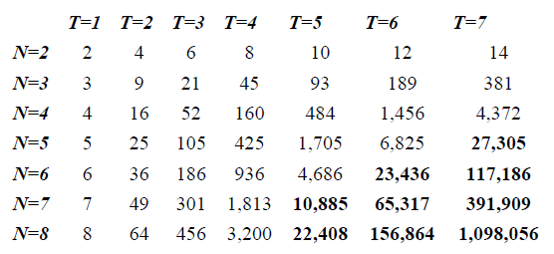
Gnutella: Reachable Users
(analytical estimate)
T : TTL, N : Neighbors for Query

Slide 30
Gnutella: Search Issue
Flooding based search is extremely wasteful with bandwidth
  A large (linear) part of the network is covered irrespective of hits found
  Enormous number of redundant messages
  All users do this in parallel: local load grows linearly with size
What search protocols can we come up with in an unstructured network
  Controlling topology to allow for better search
    Random walk, Degree-biased Random Walk
  Controlling placement of objects
    Replication

Slide 31
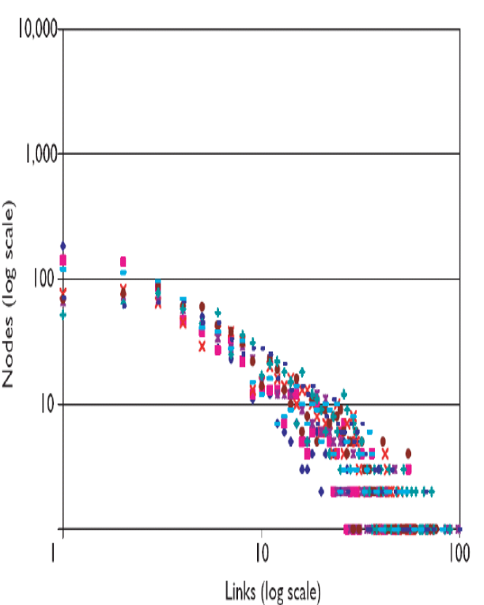
Gnutella: Random Walk
Basic strategy
  In scale-free graph: high degree nodes are easy to find by (biased) random walk
    Scale-free graph is a graph whose degree distribution follows a power law
  And high degree nodes can store the
  index about a large portion of the network
Random walk
  avoiding the visit of last visited node
Degree-biased random walk
  Select highest degree node, that has
  not been visited
  This first climbs to highest degree node,
  then climbs down on the degree sequence
  Provably optimal coverage

Slide 32
Gnutella: Replication
Spread copies of objects to peers: more popular objects can be found easier
Replication strategies
  When q_{i} is the proportion of query for object i
  Owner replication
    Results in proportional replication to q_{i}
  Path replication
    Results in square root replication to q_{i}
  Random replication
    Same as path replication to q_{i}, only using the given number of random nodes, not the path
But there is still the difficulty with rare objects.

Slide 33
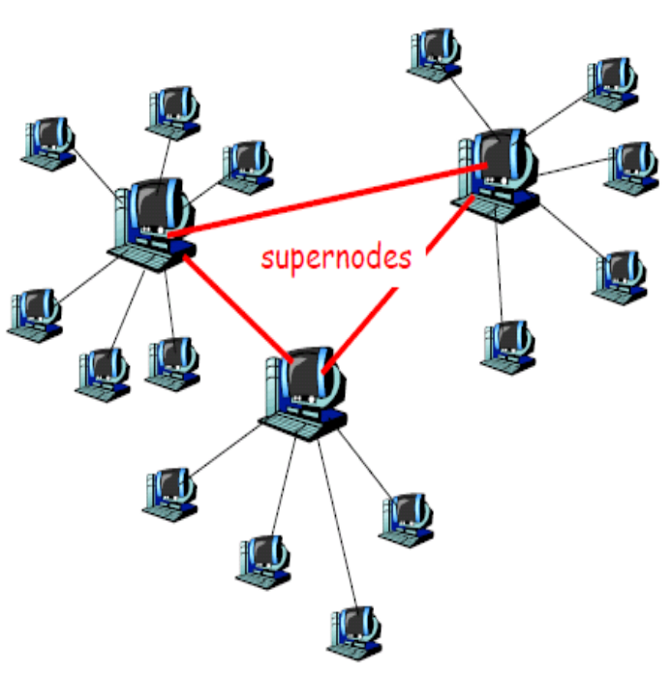
KaZaA
Hierarchical approach between Gnutella and Napster
  Two-layered architecture.
  Powerful nodes (supernodes) act as local index servers, and client queries are propagated to supernodes.
  Each supernode manages around 100-150 children
  Each supernode connects to 30-50 other supernodes
More efficient lookup than Gnutella and more scalable than Napster

Slide 34
KaZaA: SuperNode
Nodes that have more connection bandwidth and are more available are designated as supernodes
Each supernode acts as a mini-Napster hub, tracking the content (files) and IP addresses of its descendants
  For each file: File name, File size, Content Hash, File descriptors (used for keyword matches during query)
  Content Hash:
    When peer A selects file at peer B, peer A sends ContentHash in HTTP request
    If download for a specific file fails (partially completes), ContentHash is used to search for new copy of file

Slide 35
KaZaA: Parallel Downloading and Recovery
If file is found in multiple nodes, user can select parallel downloading
  Identical copies identified by ContentHash
HTTP byte-range header used to request different portions of the file from different nodes
Automatic recovery when server peer stops sending file
  ContentHash

Slide 36
Unstructured vs Structured
Unstructured P2P networks allow resources to be placed at any node. The network topology is arbitrary, and the growth is spontaneous.
Structured P2P networks simplify resource location and load balancing by defining a topology and defining rules for resource placement.
  Guarantee efficient search for rare objects
What are the rules???
Distributed Hash Table (DHT)

Slide 37
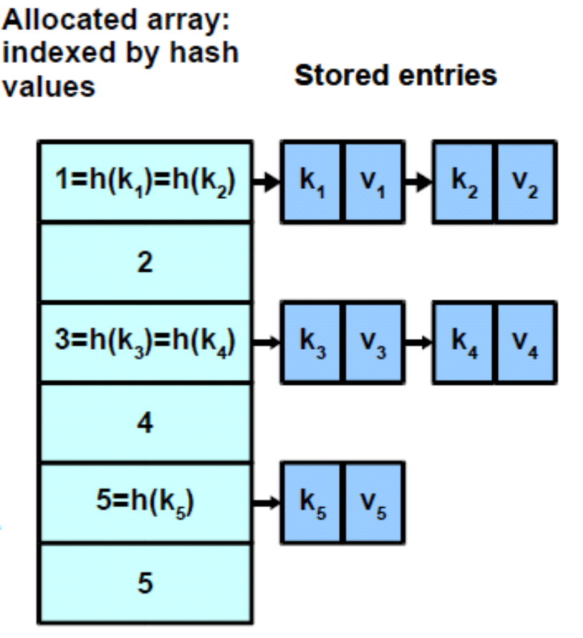
Hash Tables
Store arbitrary keys and satellite data (value)
  put(key,value)
  value = get(key)
Lookup must be fast
  Calculate hash function h() on key that returns a storage cell
  Chained hash table: Store key (and optional value) there

Slide 38
Distributed Hash Table
Hash table functionality in a P2P network: lookup of data indexed by keys
Key-hash → node mapping
  Assign a unique live node to a key
  Find this node in the overlay network quickly and cheaply
Maintenance, optimization
  Load balancing: maybe even change the key-hash → node mapping on the fly
  Replicate entries on more nodes to increase robustness

Slide 39
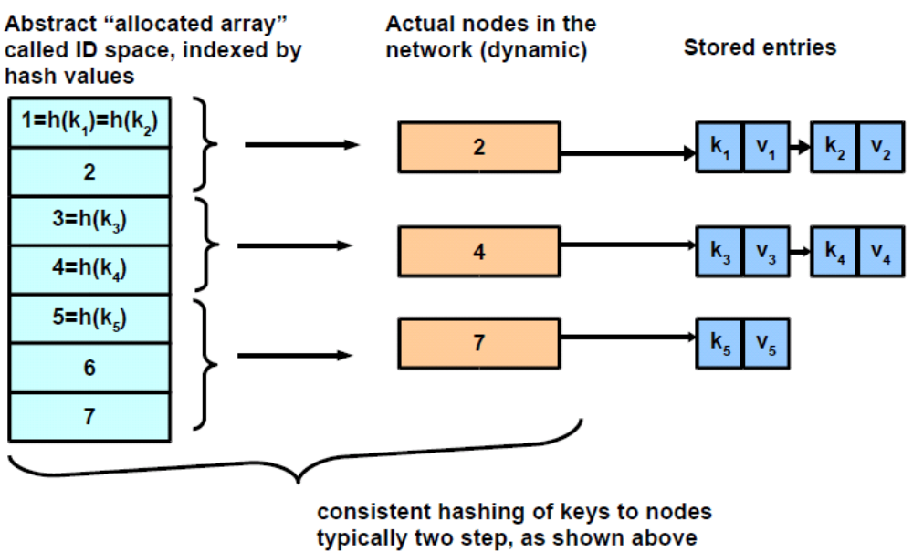
Distributed Hash Table

Slide 40
Structured P2P Systems
Chord
  Consistent hashing based ring structure
Pastry
  Uses ID space concept similar to Chord
  Exploits concept of a nested group
CAN
  Nodes/objects are mapped into a d-dimensional Cartesian space
Kademlia
  Similar structure to Pastry, but the method to check the closeness is XOR function

Slide 41
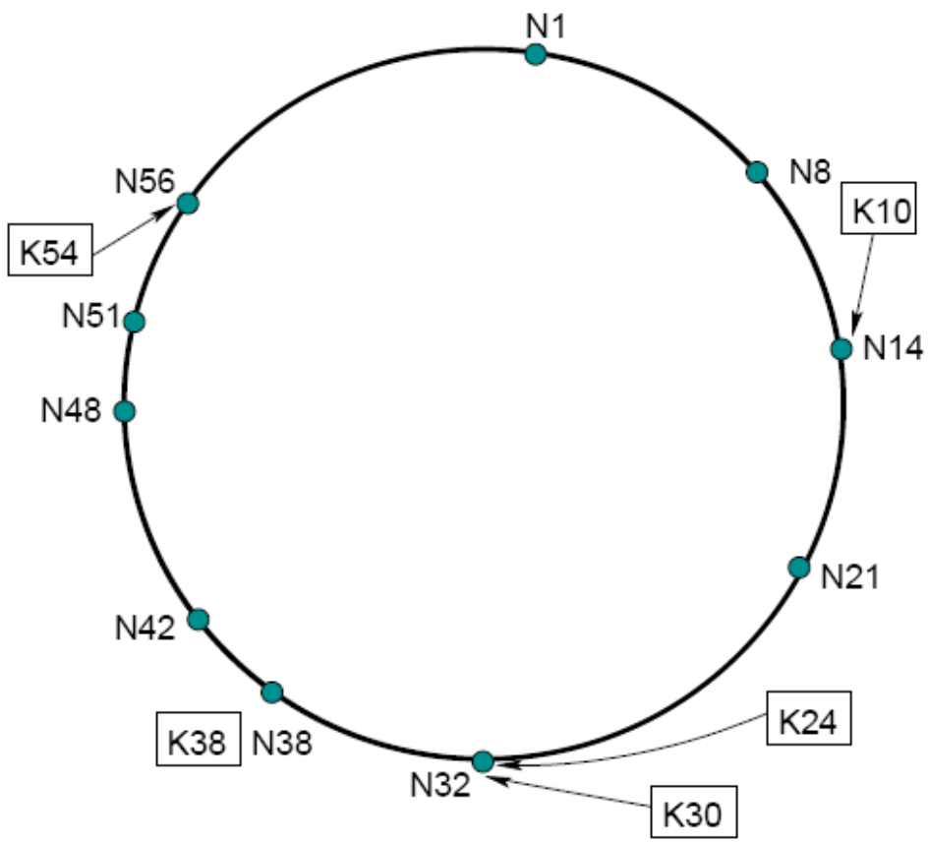
Chord
Consistent hashing based on an ordered ring overlay
Both keys and nodes are hashed to 160 bit IDs (SHA-1)
Then keys are assigned to nodes using consistent hashing
  Successor in ID space

Slide 42
How to assign keys to peers?
Central issue:
  assign (key, value) pairs to peers
Basic idea:
  Convert each key to an integer
  Assign integer to each peer
  Put (key,value) pair in the peer that is closest to the key

Slide 43
DHT identifiers
Assign integer identifier to each peer in range [0,2^{n}-1] for some n
  each identifier represented by n bits
Require each key to be an integer in same range
To get integer key, hash original key
  e.g., key = hash(“Led Zeppelin IV”)
  this is why its is referred to as a distributed “hash” table

Slide 44
Assign keys to peers
Rule: assign key to the peer that has the closest ID
Closest is the immediate successor of the key
e.g., n=4; peers: 1,3,4,5,8,10,12,14;
  key = 13, then successor peer = 14
  key = 15, then successor peer = 1

Slide 45
Circular DHT
1
3
15
4
12
5
10
8
each peer only aware of immediate successor and predecessor
“overlay network”

Slide 46
Circular DHT
0001
Who’s responsible
for key 1110 ?
O(N) messages
on average to resolve
query, when there
are N peers
I am
0011
1111
1110
1110
0100
1110
1100
1110
0101
1110
Define closest
as closest
successor
1110
1010
1000

Slide 47
Chord: Hashing Properties
Consistent hashing
  Randomized
    All nodes receive roughly equal share of load
  Local
    Adding or removing a node involves an O(1/N) fraction of the keys getting new locations
Actual lookup
  Chord needs to know only O(log N) nodes in addition to successor and predecessor to achieve O(log N) message complexity for lookup

Slide 48
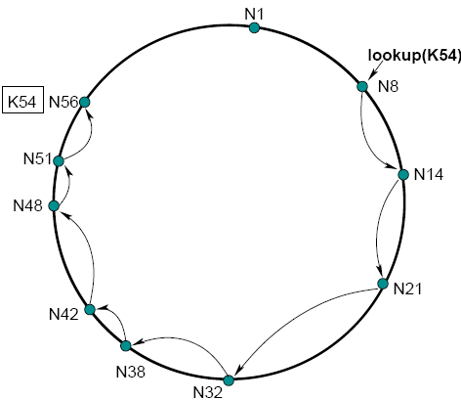
Chord: Primitive Lookup
Lookup query is forwarded to successor
  one way
Forward the query around the circle
In the worst case, O(N) forwarding is required
  In two ways, O(N/2)

Slide 49
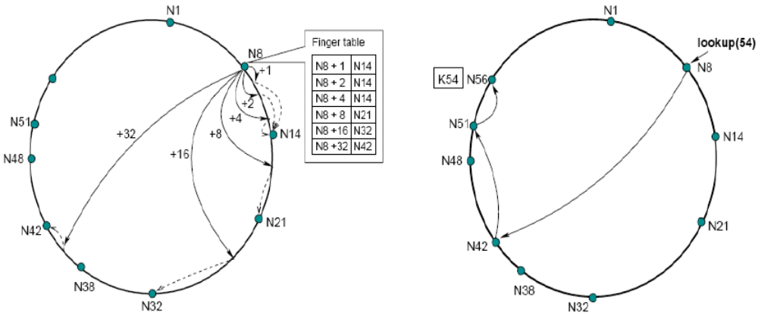
Chord: Scalable Lookup
i_{th} entry of a finger table points the successor of the key (nodeID + 2^{i})
A finger table has O(log N) entries and the scalable lookup is bounded to O(log N)

Slide 50
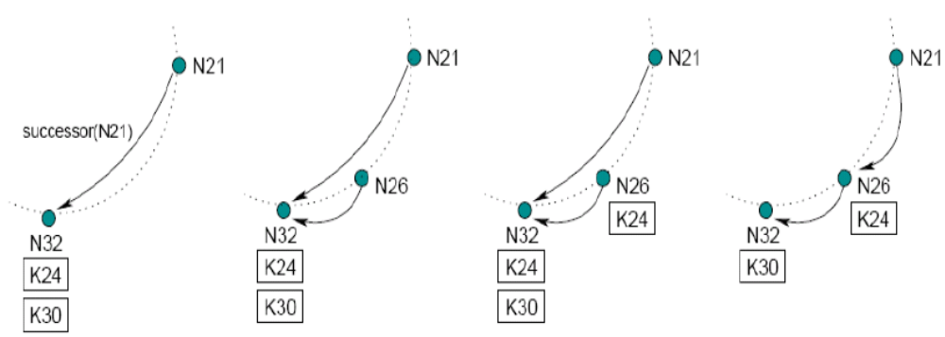
Chord: Node join
A new node has to
  Fill its own successor, predecessor and fingers
  Notify other nodes for which it can be a successor, predecessor or finger
Simpler way: Find its successor, then stabilize
  Immediately join the ring (lookup works), then modify the structure

Slide 51
Chord: Stabilization
If the ring is correct, then routing is correct, fingers are needed for the speed only
Stabilization
  Each node periodically runs the stabilization routine
  Each node refreshes all fingers by periodically calling find_successor(n+2^{i}-1) for a random i
  Periodic cost is O(logN) per node due to finger refresh

Slide 52
Chord: Failure Handling
Failed nodes are handled by
  Replication: instead of one successor, we keep r successors
    More robust to node failure (we can find our new successor if the old one fails)
  Alternate paths while routing
    If a finger does not respond, take the previous finger, or the replicas, if close enough
At the DHT level, we can replicate keys on the r successor nodes
  The stored data becomes equally more robust
Notes:
Cover bittorrent and then skype

Slide 53
Pastry
Applies a sorted ring in ID space like Chord
  Nodes and objects are assigned a 128-bit identifier
NodeID is interpreted as sequences of digit with base 2^{b}
  In practice, the identifier is viewed in base 16.
  Nested groups
Applies Finger-like shortcuts to speed up lookup
The node that is responsible for a key is numerically closest (not the successor)
  Bidirectional and using numerical distance

Slide 54
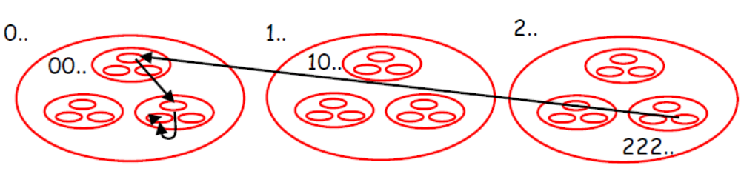
Pastry: Nested Group
Simple example: nodes & keys have n-digit base-3 ids, eg, 02112100101022
  There are 3 nested groups for each group
Each node knows IP address of one delegate node in some of the other groups
Suppose node in group 222… wants to lookup key k= 02112100210.
  Forward query to a node in 0…, then to a node in 02…, then to a node in 021…, then so on.

Slide 55
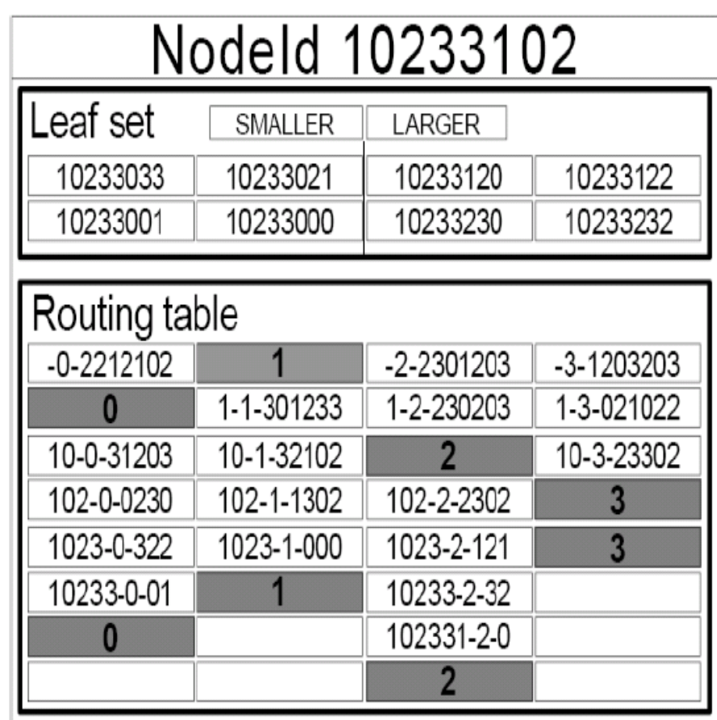
Pastry: Routing Table and LeafSet
Base-4 routing table
Routing table
  Provides delegate nodes in nested groups
  Self-delegate for the nested group where the node is belong to
  O(log N) rows
  → O(log N) lookup
Leaf set
  Set of nodes which is numerically closest to the node
    L/2 smaller & L/2 higher
  Replication boundary
  Stop condition for lookup
  Support reliability and consistency
    Cf) Successors in Chord

Slide 56
Pastry: Join and Failure
Join
  Use routing to find numerically closest node already in network
  Ask state from all nodes on the route and initialize own state
Error correction
  Failed leaf node: contact a leaf node on the side of the failed node and add appropriate new neighbor
  Failed table entry: contact a live entry with same prefix as failed entry until new live entry found, if none found, keep trying with longer prefix table entries

Slide 57
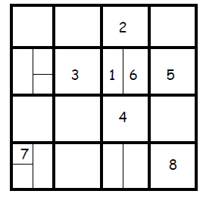
CAN: Content Addressable Network
Hash value is viewed as a point in a D-dimensional Cartesian space
  Hash value points <n1, n2, …, nD>.
Each node responsible for a D-dimensional “cube” in the space
Nodes are neighbors if their cubes “touch” at more than just a point
Example: D=2
1’s neighbors: 2,3,4,6
6’s neighbors: 1,2,4,5
Squares “wrap around”, e.g., 7 and 8 are neighbors
Expected # neighbors: O(D)

Slide 58
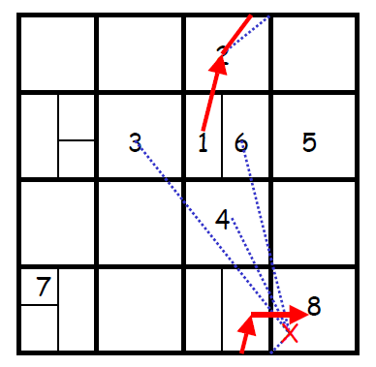
CAN: Routing
To get to <n1, n2, …, nD> from <m1, m2, …, mD>
  choose a neighbor with smallest Cartesian distance from <m1, m2, …, mD> (e.g., measured from neighbor’s center)
e.g., region 1 needs to send to node covering X
Checks all neighbors, node 2 is closest
Forwards message to node 2
Cartesian distance monotonically decreases with each transmission
Expected # overlay hops: (DN^{1/D})/4

Slide 59
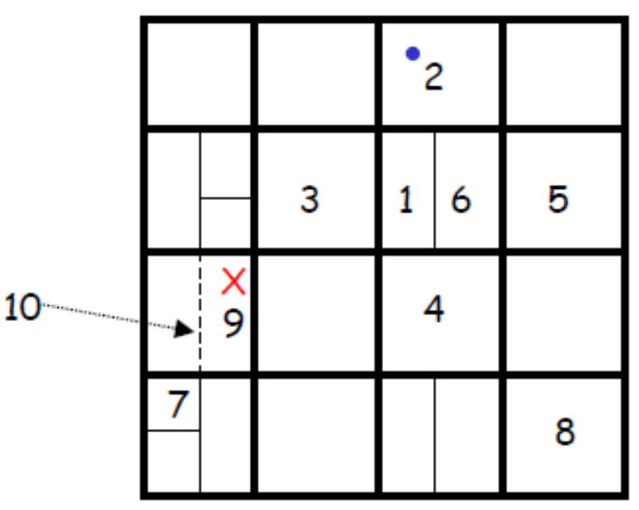
CAN: Join
To join the CAN:
  find some node in the CAN (via bootstrap process)
  choose a point in the space uniformly at random
  using CAN, inform the node that currently covers the space that node splits its space in half
    1st split along 1st dimension
    if last split along dimension i < D, next split along i+1st dimension
    e.g., for 2-d case, split on x-axis, then y-axis
  keeps half the space and gives other half to joining node
The likelihood of a rectangle being selected is proportional to it’s size, i.e., big rectangles chosen more frequently

Slide 60
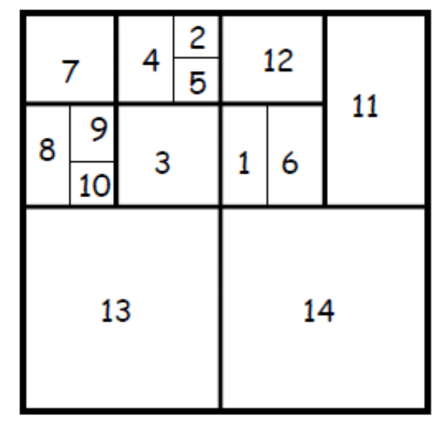
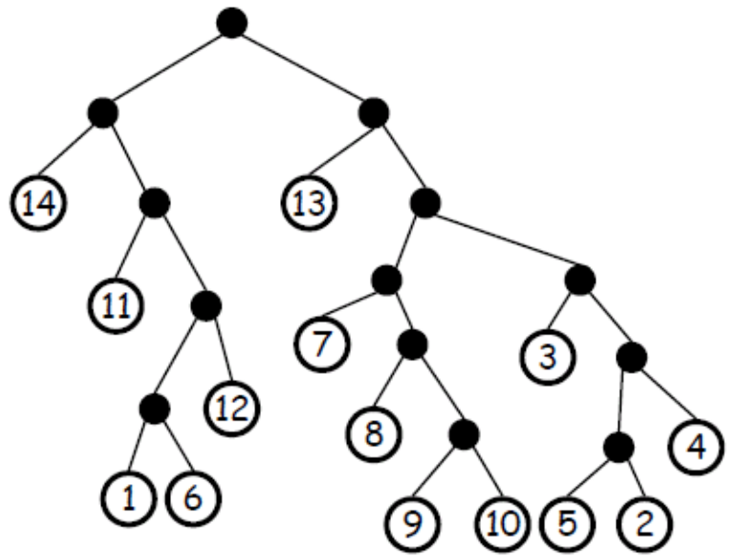
CAN Failure Recovery
View partitioning as a binary tree
  Leaves represent regions covered by overlay nodes
  Intermediate nodes represents “split” regions that could be “reformed”
  Siblings are regions that can be merged together (forming the region that is covered by their parent)

Slide 61
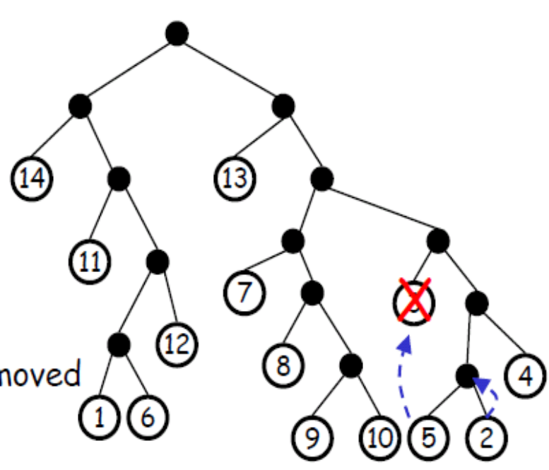
CAN Failure Recovery
Failure recovery when leaf S is removed
  Find a leaf node T that is either
    S’s sibling
    Descendant of S’s sibling where T’s sibling is also a leaf node
  T takes over S’s region (move to S’s position on the tree)
  T’s sibling takes over T’s previous region

Slide 62
Kademlia: BitTorrent DHT
For each nodes, files, keywords, deploy SHA-1 hash into a 160 bits space.
Every node maintains information about files, keywords “close to itself”.
The closeness between two objects measure as their bitwise XOR interpreted as an integer.
D(a, b) = a XOR b

Slide 63
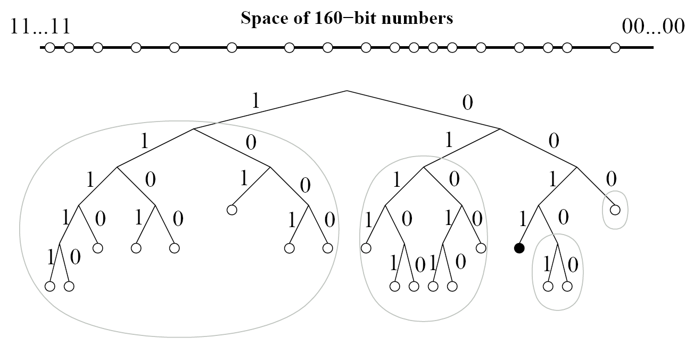
Kademlia: Binary Tree
Subtrees for node 0011….
Each subtree has k buckets
(k delegate nodes)

Slide 64
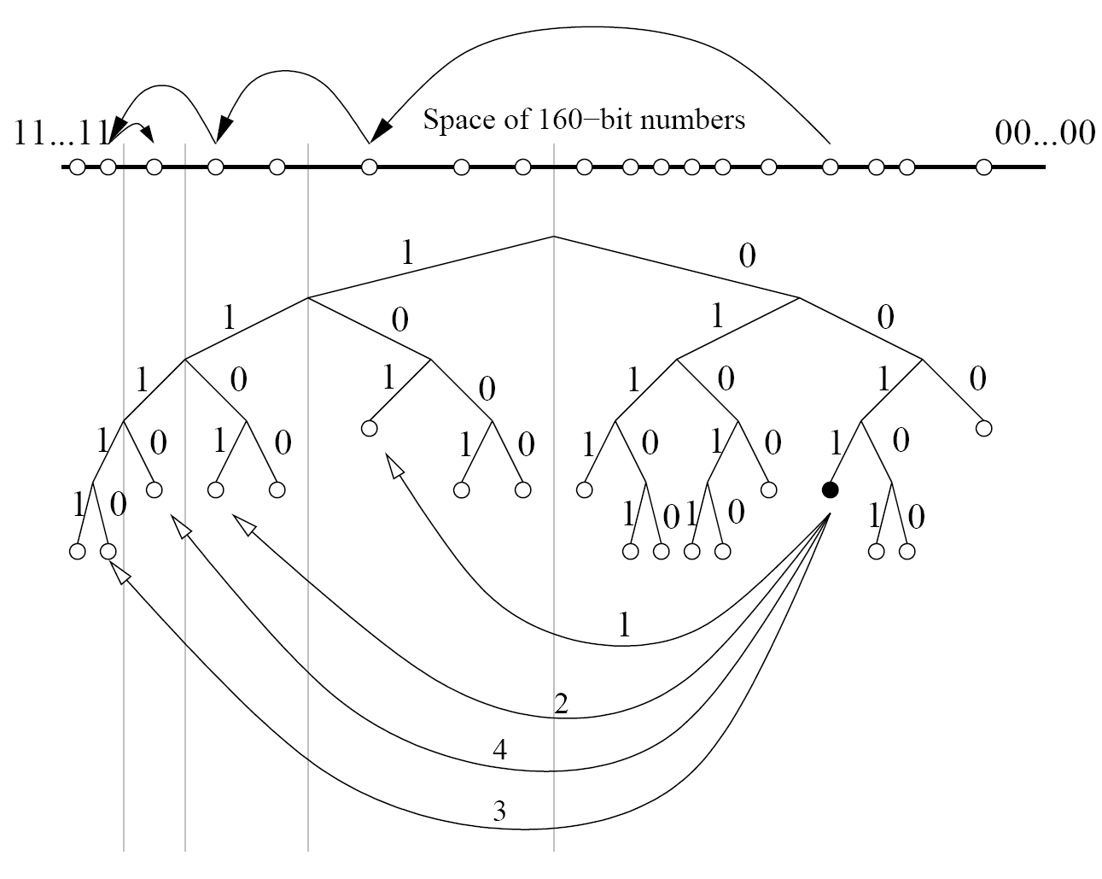
Kademlia : Lookup
When node 0011…… wants search 1110……
O(log N)

Slide 65
P2P Content Dissemination

Slide 66
Content Dissemination
Content dissemination is about allowing clients to actually get a file or other data after it has been located
Important parameters
  Throughput
  Latency
  Reliability

Slide 67
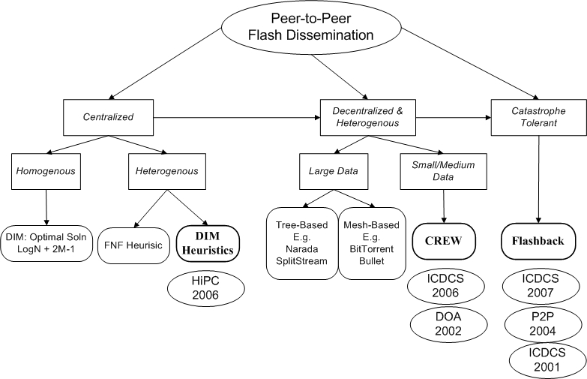
P2P Dissemination

Slide 68
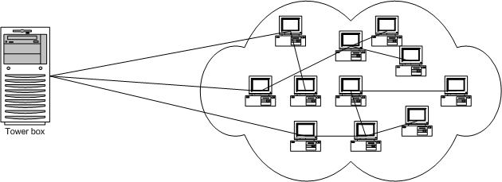
Problem Formulation
Least time to disseminate:
  Fixed data D from one seeder to N nodes
Insights / Axioms
  Involving end-nodes speeds up the process (Peer-to-Peer)
  Chunking the data also speeds up the process
Raises many questions
  How do nodes find other nodes for exchange of chunks?
  Which chunks should be transferred?
  Is there an optimal way to do this?

Slide 69
Optimal Solution in Homogeneous Network
M Chunks
Of Data
Seeder
Least time to disseminate:
  All M chunks to N-1 peers
Constraining the problem
  Homogeneous network
  All Links have same throughput & delay
  Underlying network fully connected (Internet)
N-1 Peers
Optimal Solution (DIM): Log₂N + 2(M-1)
  Ramp-Up: Until each node has at least 1 chunk
  Sustained-Throughput: Until all nodes have all chunks
There is also an optimal chunk size
FARLEY, A. M. Broadcast time in communication networks. In SIAM Journal Applied Mathematics (1980)
Ganesan, P. On Cooperative Content Distribution and the Price of Barter. ICDCS 2005

Slide 70
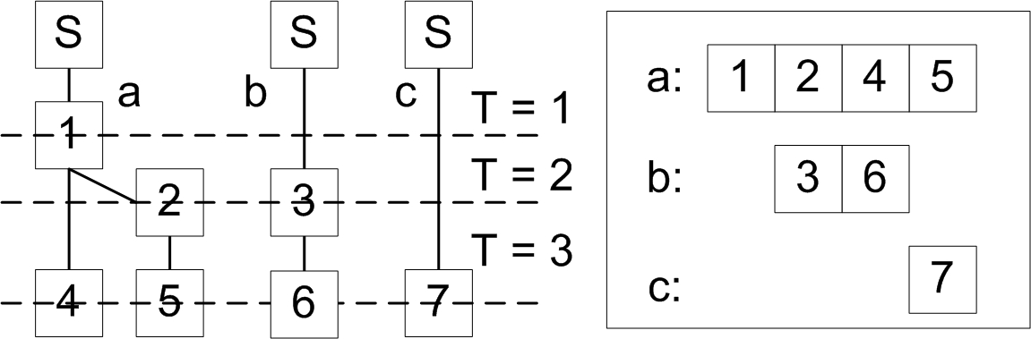
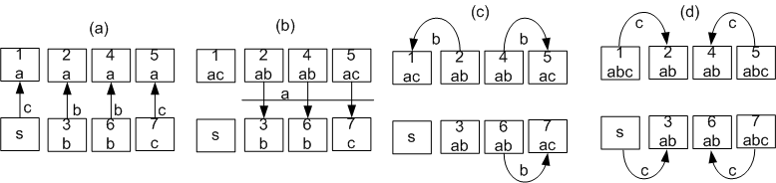
Example Working of Optimal Solution

Slide 71
Practical Content Dissemination Systems
Centralized
  Server farms behind single domain name, load balancing
Dedicated CDN
  CDN is independent system for typically many providers, that clients only download from (use it as a service), typically http
  Akamai, FastReplica
End-to-End (P2P)
  Special client is needed and clients self-organize to form the system themselves
  BitTorrent(Mesh-swarm), SplitStream(forest), Bullet(tree+mesh), CREW(mesh)

Slide 72
Akamai
Provider (eg CNN, BBC, etc) allows Akamai to handle a subset of its domains (authoritive DNS)
Http requests for these domains are redirected to nearby proxies using DNS
  Akamai DNS servers use extensive monitoring info to specify best proxy: adaptive to actual load, outages, etc
Currently 20,000+ servers worldwide, claimed 10-20% of overall Internet traffic is Akamai
Wide area of services based on this architecture
  availability, load balancing, web based applications, etc

Slide 73
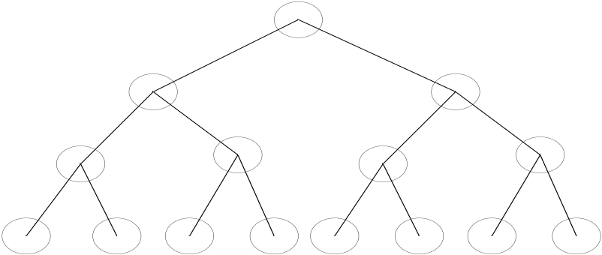
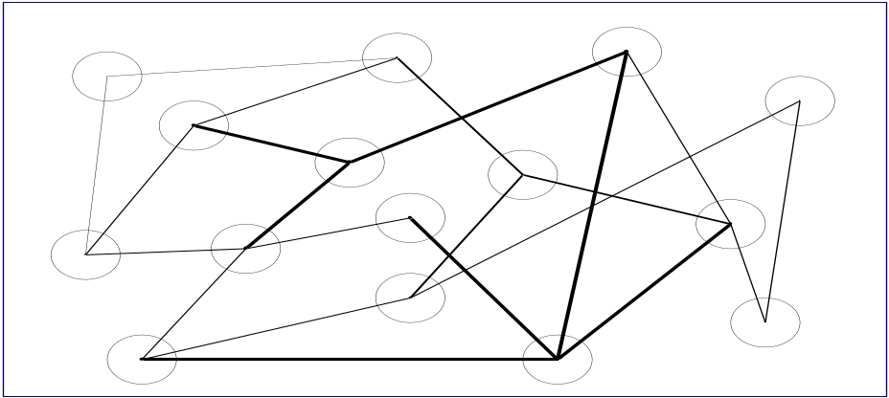
Decentralized Dissemination
Tree:
- Intuitive way to implement a
decentralized solution
- Logic is built into the
structure of the overlay
Mesh-Based (Bittorrent, Bullet):
- Multiple overlay links
- High-BW peers: more connections
- Neighbors exchange chunks
Robust to failures
- Find new neighbors when links are broken
- Chunks can be received via multiple paths
Simpler to implement
However:
Sophisticated mechanisms for heterogeneous networks (SplitStream)
- Fault-tolerance Issues
Notes:
Edges are overlay connections (TCP)

Slide 74
BitTorrent
Currently 20-50% of internet traffic is BitTorrent
Special client software is needed
  BitTorrent, BitTyrant, μTorrent, LimeWire …
Basic idea
  Clients that download a file at the same time help each other (ie, also upload chunks to each other)
  BitTorrent clients form a swarm : a random overlay network

Slide 75
BitTorrent: Publish/download
Publishing a file
  Put a “.torrent” file on the web: it contains the address of the tracker, and information about the published file
  Start a tracker, a server that
    Gives joining downloaders random peers to download from and to
    Collects statistics about the swarm
  There are “trackerless” implementations by using Kademlia DHT (e.g. Azureus)
Download a file
  Install a bittorrent client and click on a “.torrent” file

Slide 76
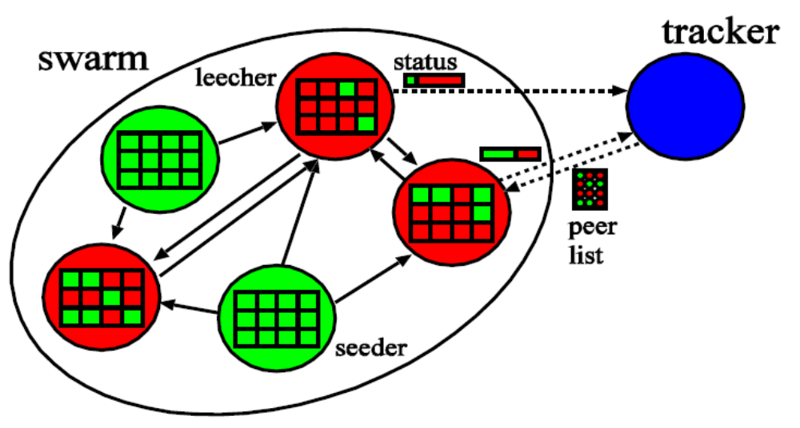
BitTorrent: Overview
File.torrent :
-URL of tracker
File name
File length
Chunk length
Checksum for each chunk (SHA1 hash)
Seeder – peer having entire file
Leecher – peer downloading file

Slide 77
BitTorrent: Client
Client first asks 50 random peers from tracker
  Also learns about what chunks (256K) they have
Pick a chunk and tries to download its pieces (16K) from the neighbors that have them
  Download does not work if neighbor is disconnected or denies download (choking)
  Only a complete chunk can be uploaded to others
Allow only 4 neighbors to download (unchoking)
  Periodically (30s) optimistic unchoking : allows download to random peer
    important for bootstrapping and optimization
  Otherwise unchokes peer that allows the most download (each 10s)

Slide 78
BitTorrent: Tit-for-Tat
Tit-for-tat
  Cooperate first, then do what the opponent did in the previous game
BitTorrent enables tit-for-tat
  A client unchokes other peers (allow them to download) that allowed it to download from them
  Optimistic unchocking is the initial cooperation step to bootstrapping

Slide 79
BitTorrent: Chunk Selection
What chunk to select to download?
Clients select the chunk that is rarest among the neighbors ( Local decision )
  Increases diversity in the pieces downloaded; Increase throughput
  Increases likelihood all pieces still available even if original seed leaves before any one node has downloaded entire file
Except the first chunk
  Select a random one (to make it fast: many neighbors must have it)

Slide 80
BitTorrent: Pros/Cons
Pros
  Proficient in utilizing partially downloaded files
  Encourages diversity through “rarest-first”
    Extends lifetime of swarm
  Works well for “hot content”
Cons
  Assumes all interested peers active at same time; performance deteriorates if swarm “cools off”
  Even worse: no trackers for obscure content

Slide 81
Overcome Tree Structure –
SplitStream, Bullet
Tree
  Simple, Efficient, Scalable
  But, vulnerable to failures, load-unbalanced, no bandwidth constraint
SplitStream
  Forest (Multiple Trees)
Bullet
  Tree(Metadata)
  + Mesh(Data)
CREW
  Mesh(Data,Metadata)

Slide 82
SplitStream
Forest based dissemination
Basic idea
  Split the stream into K stripes (with MDC coding)
  For each stripe create a multicast tree such that the forest
    Contains interior-node-disjoint trees
    Respects nodes’ individual bandwidth constraints
Approach
  On the Pastry and Scribe(pub/sub)

Slide 83
SplitStream: MDC coding
Multiple Description coding
  Fragments a single media stream into M substreams (M ≥ 2 )
  K packets are enough for decoding (K < M)
  Less than K packets can be used to approximate content
    Useful for multimedia (video, audio) but not for other data
    Cf) erasure coding for large data file

Slide 84
SplitStream: Interior-node-disjoint tree
Each node in a set of trees is interior node in at most one tree and leaf node in the other trees.
Each substream is disseminated over subtrees
S
ID =0x…
ID =1x…
ID =2x…
a
a
a
d
d
d
g
g
g
b
b
b
c
c
c
e
e
e
f
f
f
h
h
h
i
i
i

Slide 85
SplitStream: Constructing the forest
Each stream has its groupID
  Each groupID starts with a different digit
A subtree is formed by the routes from all members to the groupId
  The nodeIds of all interior nodes share some number of starting digits with the subtree’s groupId.
All nodes have incoming capacity requirements (number of stripes they need) and outgoing capacity limits

Slide 86
Bullet
Layers a mesh on top of an overlay tree to increase overall bandwidth
Basic Idea
  Use a tree as a basis
  In addition, each node continuously looks for peers to download from
  In effect, the overlay is a tree combined with a random network (mesh)

Slide 87
Bullet: RanSub
Two phases
  Collect phase : using the tree, membership info is propagated upward (random sample and subtree size)
  Distribution phase : moving down the tree, all nodes are provided with a random sample from the entire tree, or from the non-descendant part of the tree
1
2
3
4
5
6
7
S
1
2
3
5
1
3
4
6
2
4
5
6
A
B
C
1
2
5
D
E
1
3
4

Slide 88
Bullet: Informed content delivery
When selecting a peer, first a similarity measure is calculated
  Based on summary-sketches
Before exchange missing packets need to be identified
  Bloom filter of available packets is exchanged
  Old packets are removed from the filter
    To keep the size of the set constant
Periodically re-evaluate senders
  If needed, senders are dropped and new ones are requested

Slide 89
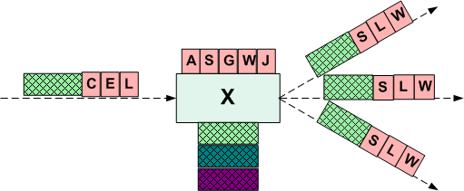
Gossip-based Broadcast
Probabilistic Approach with Good Fault Tolerant Properties
  Choose a destination node, uniformly at random, and send it the message
  After Log(N) rounds, all nodes will have the message w.h.p.
  Requires N*Log(N) messages in total
  Needs a ‘random sampling’ service
Usually implemented as
  Rebroadcast ‘fanout’ times
  Using UDP: Fire and Forget
BiModal Multicast (99), Lpbcast (DSN 01), Rodrigues’04 (DSN), Brahami ’04, Verma’06 (ICDCS), Eugster’04 (Computer), Koldehofe’04, Periera’03

Slide 90
Gossip-based Broadcast: Drawbacks
Problems
  More faults, higher fanout needed (not dynamically adjustable)
  Higher redundancy → lower system throughput → slower dissemination
  Scalable view & buffer management
  Adapting to nodes’ heterogeneity
  Adapting to congestion in underlying network

Slide 91
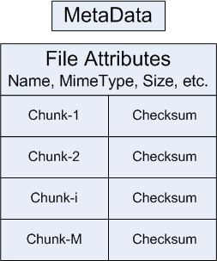
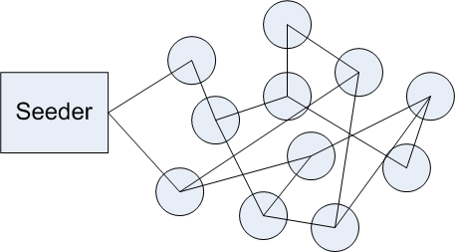
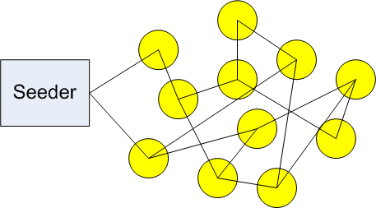
CREW: Preliminaries
Deshpande, M., et al. CREW: A Gossip-based Flash-Dissemination System IEEE International Conference on Distributed Computing Systems (ICDCS). 2006.

Slide 92
CREW (Concurrent Random Expanding Walkers) Protocol
Basic Idea: Servers ‘serve’ data to only a few clients
  Who In turn become servers and ‘recruit’ more servers
Split data into chunks
  Chunks are concurrently disseminated through random-walks
Self-scaling and self-tuning to heterogeneity
2
1
2
3
1
1
3
2
3
4
5
4
5
6
6

Slide 93
What is new about CREW
No need to pre-decide fanout or complex protocol to adjust it
  Deterministic termination
  Autonomic adaptation to fault level (More faults →more pulls)
Scalable, real-time and low-overhead view management
  Number of neighbors as low as Log(N) (expander overlay)
  Neighbors detect and remove dead node → disappears from all nodes’ views instantly
  List of node addresses not transmitted in each gossip message
Use of metadata plus handshake to reduce data overhead
  No transmission of redundant chunks
Handshake overloading
  For ‘random sampling’ of the overlay
  Quick feedback about system-wide properties
  Quick adaptation
Use of TCP as underlying transport
  Automatic flow and congestion control at network level
  Less complexity in application layer
Implemented using RPC middleware

Slide 94
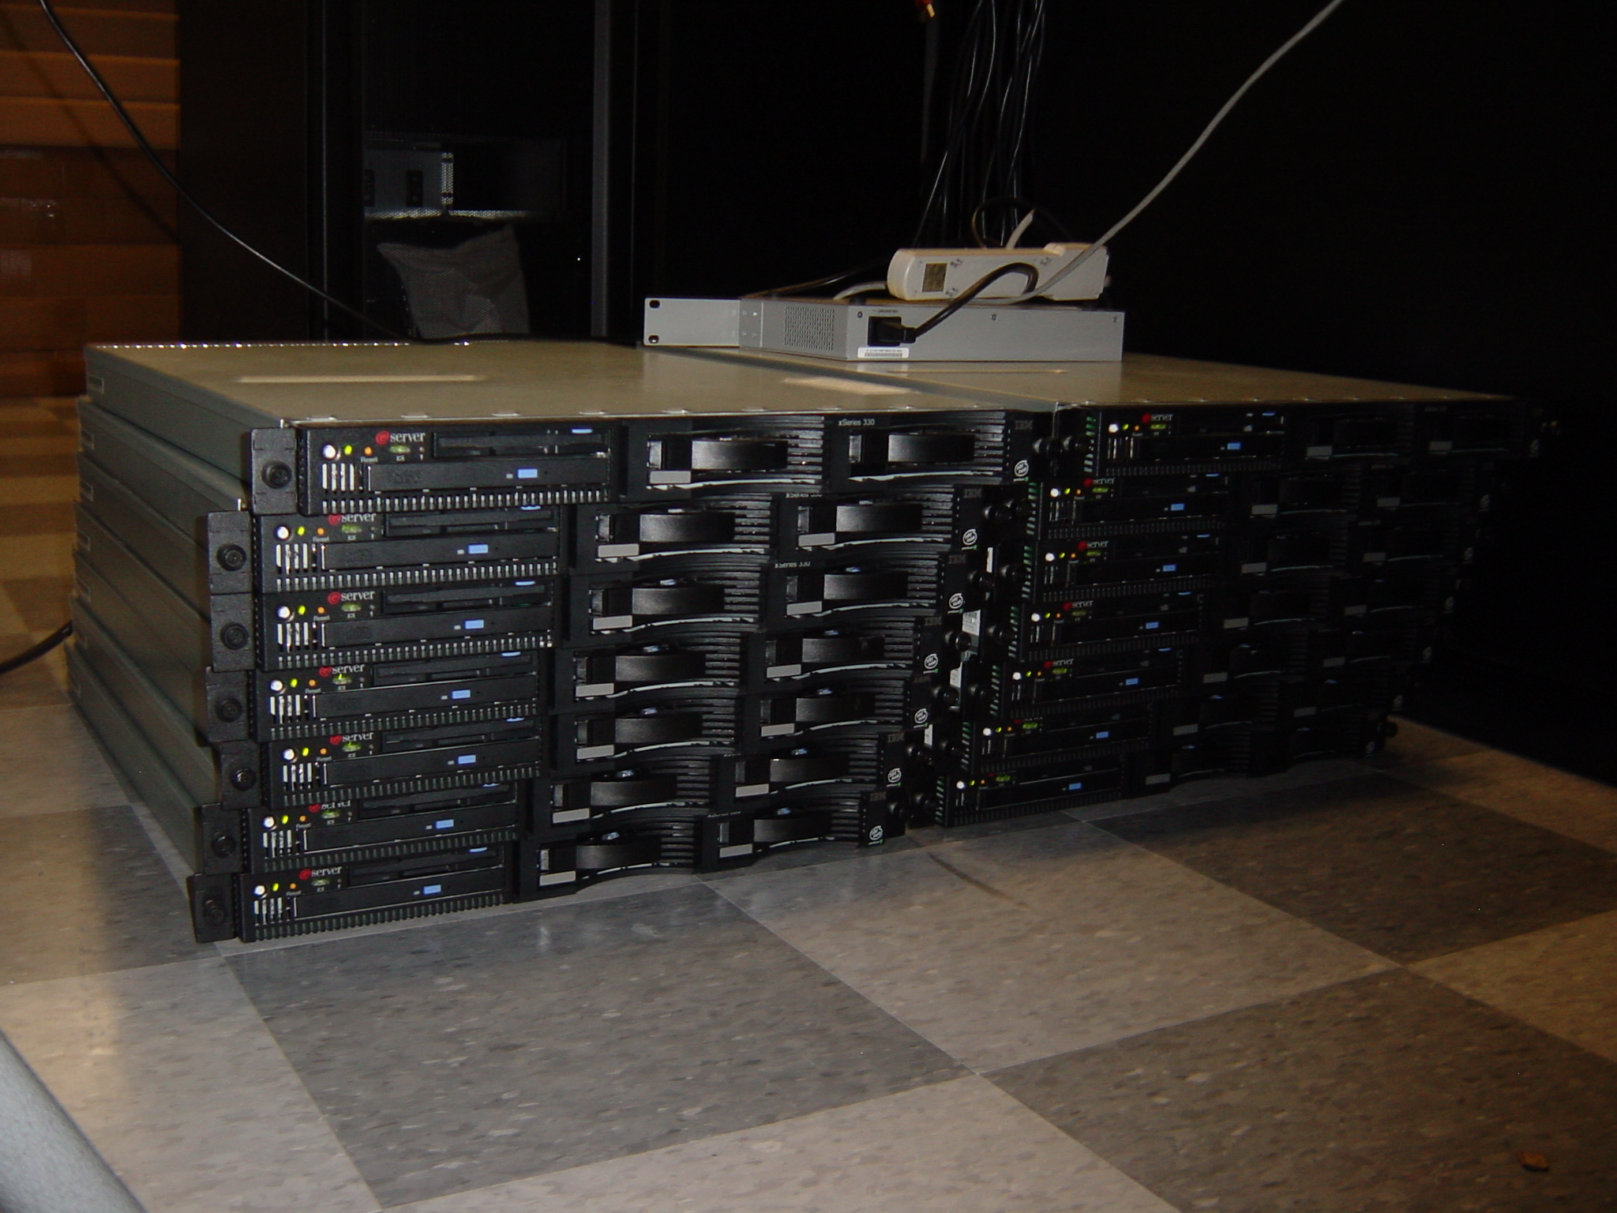
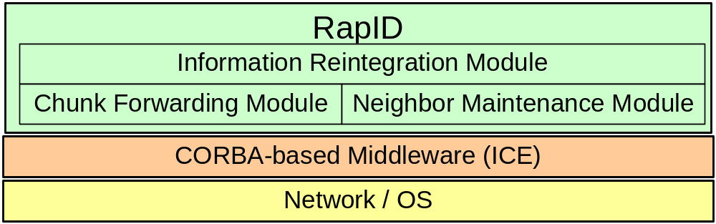
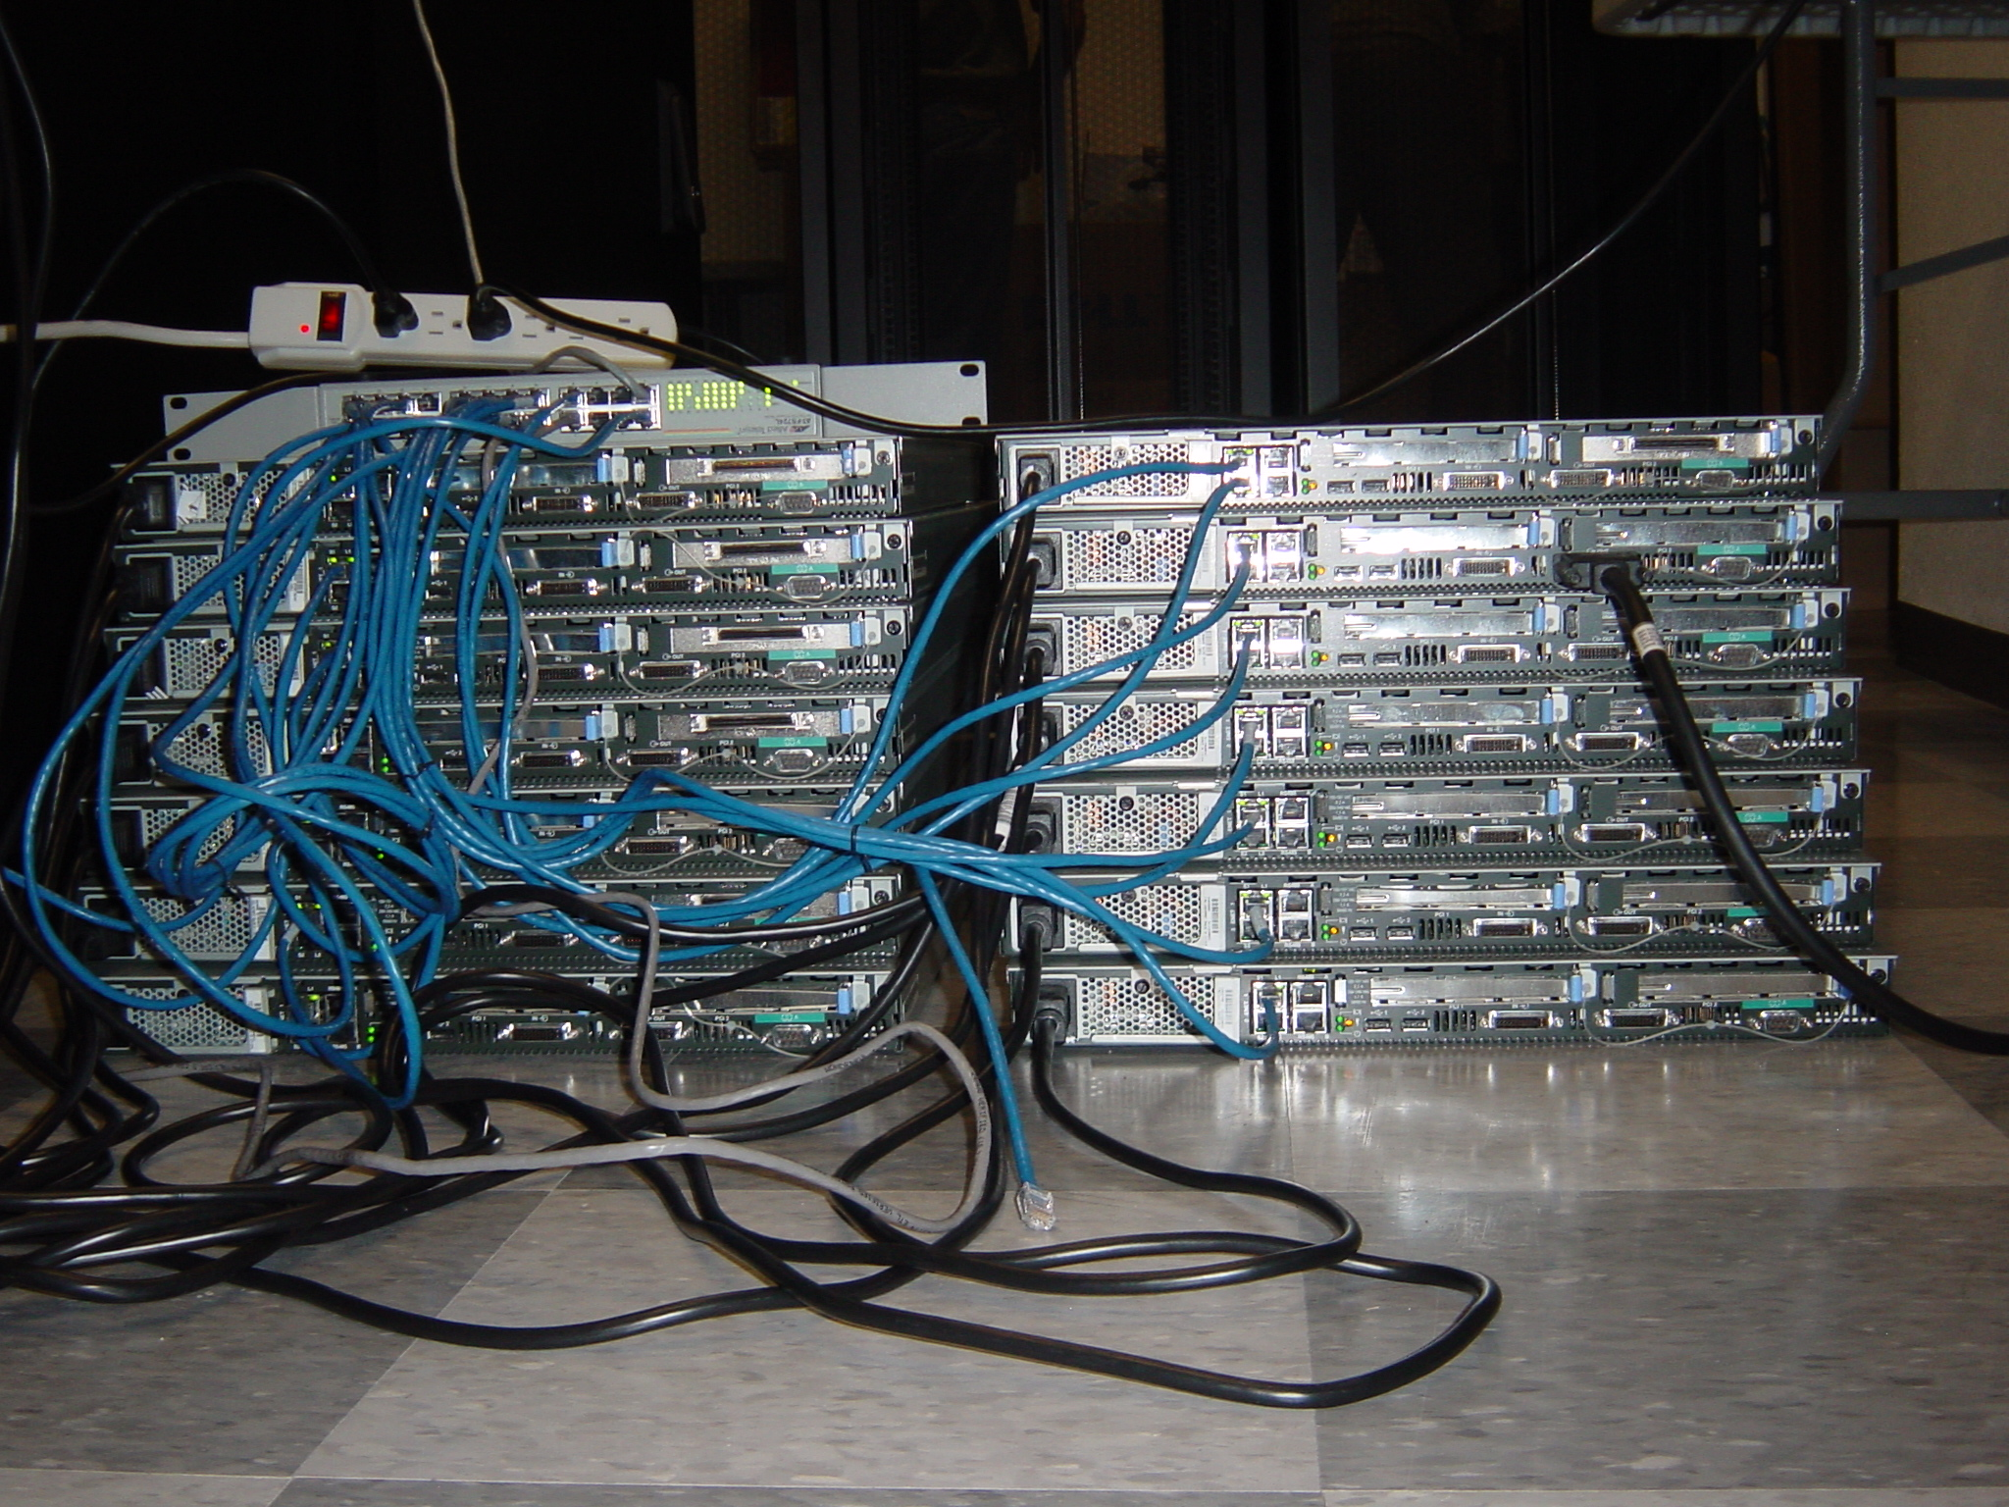
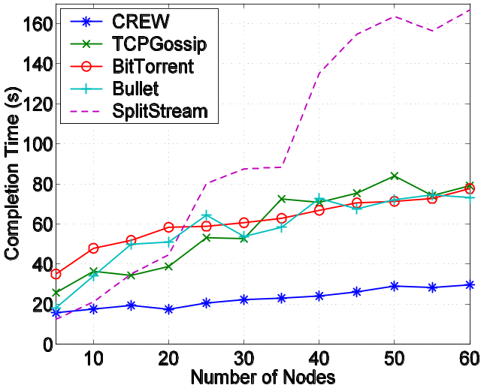
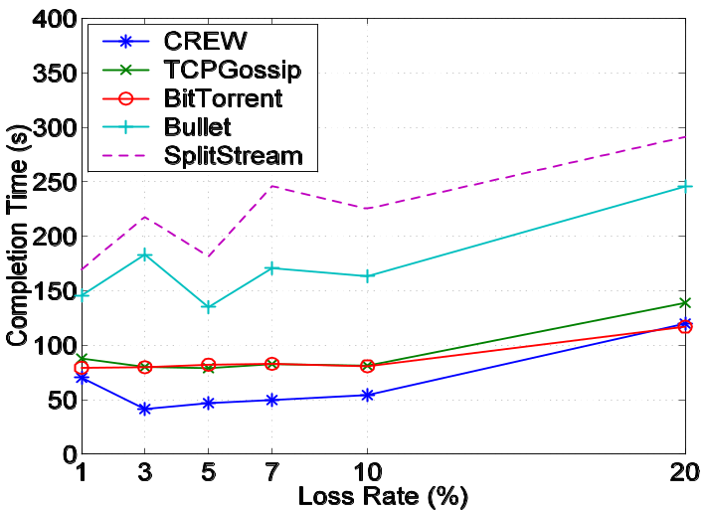
CREW Protocol: Latency, Reliability
Notes:
Bullet is also able to take advantage of high-BW nodes

Slide 95
Fast Replica
Disseminate large file to large set of edge servers or distributed CDN servers
Minimization of the overall replication time for replicating a file F across n nodes N₁, … , N_{n.}
File F is divides in n equal subsequent files:
F₁, … , F_{n,} where Size(F_{i}) = Size(F) / n bytes for each i = 1, … , n.
Two steps of dissemination
  Distribution and Collection

Slide 96
FastReplica: Distribution
N₂
N₃
F₃
N _{n-1}
F₂
F _{n-1}
N₁
F₁
F _{n}
N _{n}
File F
N₀
F₁
F₂
F₃
F _{n-1}
F _{n}
Origin node N0 opens n concurrent connections to nodes N1, … , Nn and sends to each node the following items:
  a distribution list of nodes R = {N1, … , Nn} to which subfile Fi has to be sent on the next step;
  subfile Fi .

Slide 97
FastReplica: Collection
N₃
F₃
F₂
N₂
N _{n-1}
F₁
F₁
F _{n-1}
F₁
F₁
N₁
F _{n}
F₁
N _{n}
File F
N₀
F₁
F₂
F₃
F _{n-1}
F _{n}
After receiving Fi , node Ni opens (n-1) concurrent network connections to remaining nodes in the group and sends subfile Fi to them

Slide 98
FastReplica: Collection (overall)
N₃
F₃
F₂
N₂
N _{n-1}
F₂
F₃
F _{n-1}
F _{n-1}
F₁
N₁
F _{n}
F _{n}
N _{n}
File F
N₀
F₁
F₂
F₃
F _{n-1}
F _{n}
Each node N i has:
  (n - 1) outgoing connections for sending subfile F i ,
  (n - 1) incoming connections from the remaining nodes in the group for sending complementary subfiles F 1, … , F i-1 ,F i+1 , … , F n.

Slide 99
FastReplica: Benefits
Instead of typical replication of the entire file F to n nodes using n Internet paths FastReplica exploits (n x n) different Internet paths within the replication group, where each path is used for transferring 1/n-th of file F.
Benefits:
  The impact of congestion along the involved paths is limited for a transfer of 1/n-th of the file,
  FastReplica takes advantage of the upload and download bandwidth of recipient nodes.

